Slide 1
Apache Airflow Blinken OSA case study
József Gábor Bóné - Head of IT bonej@ceu.edu github.com/BlinkenOSA/workflows
Notes:
In this short presentation I'd like show how we are using Airflow and what kind of microservices are we managing with the help of this tool.

Slide 2
Docker containers
postgres:9.6
database server for permanent storage
puckel/docker-airflow
apache airflow in a docker container
nightseas/ffmpeg
ffmpeg with compiled CUDA drivers*
* server is equipped with NVIDIA GTX 1080
Notes:
On the workflow server we are using docker to keep the building blocks (postgres, airflow, ffmpeg) separated. Changing configuration and updates are easier this way.
When an external hard drive arrives we mount to our workflow server and start/restart our docker containers. Once everything is up and running, we trigger the workflow with a mouse-click on the Airflow web UI.

Slide 3
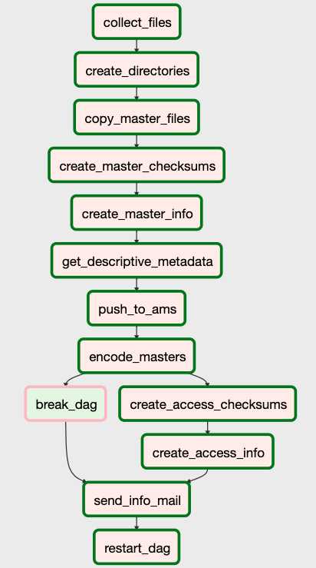
Preservation workflow for video files - steps
collect_files
Input
Directory with filenames in the format of OSA barcrode. Example: HU_OSA_00000011.avi
OR
Directories with names in the format of OSA barcode. Example: HU_OSA_00000011/movie.avi
Task
Picks up the first file from the input directory, moves it to a working directory and places the name and location into 'videofiles.json' file.
Example:
{'HU OSA 00000011': '/opt/videos/av_hdd/HU_OSA_00000011.avi'}
Notes:
Now I would like to go through each workflow tasks and shortly explain their behavior.
Each workflow step is a python script (which you can find on github) which can run in airflow or in standalone mode as well. This made development and testing quiet easy.
In the first step we are checking the input directory for files or directories which fulfill the pre-defined naming convention (should be a barcode).
The first barcode and the path for the master file gets written to the file 'videofile.json'. The barcode will be the key and the full path will be the value.

Slide 4
Preservation workflow for video files - steps
create_directories
Task:
Create directory structure for the AIP.
Example:
HU_OSA_00000011
Content
Access
Preservation
Metadata
Access
Preservation
Notes:
Next we create the directory structure of the AIP in the output folder (which is defined as an environmental variable).
The barcode is picked up from the videofiles.json file.

Slide 5
Preservation workflow for video files - steps
copy_master_files
Task:
Move master file to the appropriate directory.
Example:
HU_OSA_00000011
Content
Access
Preservation
HU_OSA_00000011.avi
Metadata
Access
Preservation
Notes:
Master file is moved to the AIP directory.

Slide 6
Preservation workflow for video files - steps
create_master_checksums
Task:
Create md5 and sha512 checksums for the master file.
Example:
HU_OSA_00000011
Content
Access
Preservation
HU_OSA_00000011.avi
Metadata
Access
Preservation
HU_OSA_00000011.md5
HU_OSA_00000011.sha512
Notes:
We chose to create both md5 and sha512 checksums with pythons hashlib library.

Slide 7
Preservation workflow for video files - steps
create_master_info
Task:
Save the output of 'ffprobe' command for master.
Example:
HU_OSA_00000011
Content
Access
Preservation
HU_OSA_00000011.avi
Metadata
Access
Preservation
HU_OSA_00000011.md5
HU_OSA_00000011.sha512
HU_OSA_00000011_md_tech.json
Notes:
We are calling ffprobe (which is running in the ffmpeg docker container) from inside airflows docker container and saving it's json output.
For calling an another docker container from inside a container we used pythons docker library.
FFMPEG is run with pythons subprocess library.

Slide 8
Preservation workflow for video files - steps
get_descriptive_metadata
Task:
If exists save descriptive metadata by querying the API (HTTP GET) of the Archival Management System.
Example:
HU_OSA_00000011
Content
Access
Preservation
HU_OSA_00000011.avi
Metadata
Access
Preservation
HU_OSA_00000011.md5
HU_OSA_00000011.sha512
HU_OSA_00000011_md_descriptive.json
HU_OSA_00000011_md_tech.json
Notes:
With requests library we are fetching the descriptive metadata from OSAs Archival Management System and saving the results in a json file.

Slide 9
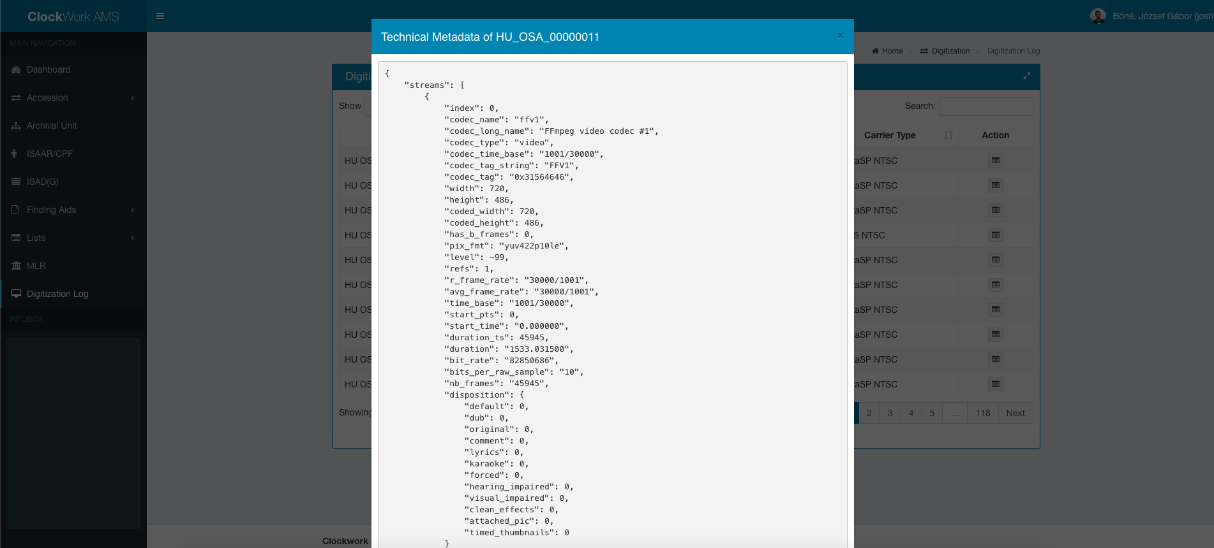
Preservation workflow for video files - steps
push_to_ams
Task:
Save technical metadata in the Archival Management System by submitting it to the API (HTTP POST).
Example:
Notes:
Similar to the previous step using requests library we submit the technical metadata (extracted with ffprobe) to the REST API endpoint of the Archival Management System.
AMS saves this information in its database and sets an indicator showing that a certain material has finished it's preservation circle. Setting this indicator enable AMS to display the state of digitization in a Digitization Log giving feedback for staff members.

Slide 10
Preservation workflow for video files - steps
push_to_ams
Error:
If the barcode can't be found in the AMS, OSA AV digitization staff gets an email with a warning message.
Example:
Notes:
If the barcode can't be found (because it wasn't registered in the AMS - POST requests gives back a 404 error) a notification mail is sent to OSA staff to warn them about the fact.

Slide 11
Preservation workflow for video files - steps
encode_masters
Task:
Create high quality access copy from the master file (h.264 / yuv420p / 7.5M)
Example:
HU_OSA_00000011
Content
Access
HU_OSA_00000011.mp4
Preservation
HU_OSA_00000011.avi
Metadata
Access
Preservation
HU_OSA_00000011.md5
HU_OSA_00000011.sha512
...
Notes:
A high quality mp4 file – a so called access copy - is created with ffmpeg. This file is also kept separately from the AIP for further processing (viewing copy, programme level cuts).

Slide 12
Preservation workflow for video files - steps
create_access_checksums + create_access_info
Task:
Create md5 and sha512 checksums and technical metadata similar as we did with master files.
Example:
HU_OSA_00000011
Content
Access
HU_OSA_00000011.mp4
Preservation
HU_OSA_00000011.avi
Metadata
Access
HU_OSA_00000011.md5
HU_OSA_00000011.sha512
HU_OSA_00000011_md_tech.json
Preservation
...
Notes:
Creating the same type of checksums and technical info for access copies.

Slide 13
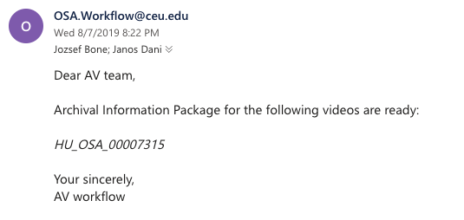
Preservation workflow for video files - steps
send_info_mail
Task:
Send notification email about finishing the workflow.
Example:
Notes:
With airflows email pakage send a mail to OSA staff about the status of the workflow. Airflow email package is using the settings for smtp defined in airflows own config file.

Slide 14
Preservation workflow for video files - steps
restart_dag
Task:
Checks if there are master files left in the input directory. If yes, then triggers running the DAG once again, if not exits.
Notes:
If there are files left in the input directory the DAG is retriggered with TriggerDagRunOperator.

Slide 15
Saving AIP
AIP Structure
HU_OSA_00000011 Content Access HU_OSA_00000011.mp4 Preservation HU_OSA_00000011.avi Metadata Access HU_OSA_00000011.md5 HU_OSA_00000011.sha512 HU_OSA_00000011_md_tech.json Preservation HU_OSA_00000011.md5 HU_OSA_00000011.sha512 HU_OSA_00000011_md_descriptive.json HU_OSA_00000011_md_tech.json
Storing AIPs
AIPs are written to two simultaneous LTO tapes (currently LTO-7) which will be kept in two separate locations.
A lower quality mp4 file will be made and – depending on copyright – either uploaded to our catalog or to our SharePoint based Research Cloud for internal use.
Notes:
This is the final structure of our AIP which are written to two simultaneous LTO tapes (currently LTO-7) which are kept in two separate locations.
A lower quality mp4 file is made and – depending on copyright – either uploaded to our catalog or to our sharepoint based Research Cloud for internal use.
(At the moment this is a manual step, but we plan to extend the workflow).

Slide 16
Errors & Improvements
Errors:
ffmpeg sometimes creates mp4 files with 0 bytes
solution: The encoding task should check the length of the access copy and redo the procedure if the size is 0 bytes.
manual mistakes (missing barcodes in AMS)
solution: Implement a procedure where retriggering certain workflow steps are available with certain signals (like replying an email)
Improvements:
+ splitting DAGs to be able to retrigger certain parts of the workflow.
+ create and add information to PREMIS with every preservation step.
+ include a step to create lower quality mp4 files for web use. Sync them with SharePoint if needed.
+ create other workflows for DVD and audio preservation.
+ create a workflow for automated quality check analysis and feedback for OSA AV staff.
plans for 2020
Notes:
With new tech there are always errors discovered and with every implementations there are improvements to make.

Slide 17
So far...
1200 physical containers were digitized and made available for researchers with this workflow.

Slide 18
Thank you!
Questions are welcomed.

